Slide 1
X10: Computing at Scale
Vijay Saraswat
http://www.research.ibm.com/x10
This work has been supported in part by the Defense Advanced Research Projects Agency (DARPA) under contract No. NBCH30390004.

Slide 2
Acknowledgements
X10 core team*
  Philippe Charles
  Chris Donawa (IBM Toronto)
  Christian Grothoff (UCLA)
  Allan Kielstra (IBM Toronto)
  Douglas Lovell
  Christoph von Praun
  Vijay Saraswat
  Vivek Sarkar
Additional contributors to X10 ideas:
David Bacon, Bob Blainey, Perry Cheng, Julian Dolby, Guang Gao (U Delaware), Robert O'Callahan, Filip Pizlo (Purdue), Lawrence Rauchwerger (Texas A&M), Mandana Vaziri, Jan Vitek (Purdue), V.T. Rajan, Radha Jagadeesan (DePaul), Maged Michael, Armando Solar-Lezama (UC Berkeley)
X10 Tools
Julian Dolby, Steve Fink, Robert Fuhrer, Matthias Hauswirth, Peter Sweeney, Frank Tip, Mandana Vaziri
X10 Static Analysis
Julian Dolby, Ras Bodik, Satish Chandra
University partners:
MIT (StreamIt), Purdue University (X10), UC Berkeley (StreamBit), U. Delaware (Atomic sections), U. Illinois (Fortran plug-in, HTA), Vanderbilt University (Productivity metrics), DePaul U (Semantics)
X10 PM+Tools Team Lead*: Vivek Sarkar
PERCS Software Lead: Rama Govindaraju
PERCS Principal Investigator: Mootaz Elnozahy
(*)Emeritus: Kemal Ebcioglu

Slide 3
Software Architecture - 2010: Vision
Compilers
CPO
DB
SMT Exploitation
Cache injection
Adv. Funcs
Productivity Enhancers
ILM
COE
User Space
APPLICATION
Kernel Space
ESSL
PESSL
SHMEM
GPFS
SOCKETS
Operating Systems
UPC
X10
VSD/NSD
TCP
UDP
CSM, RSCT
IBM’s MPI
LL
LAPI
DD
HYP
IP
HAL
IF_LS
Network Adapter
HMC
Network

Slide 4
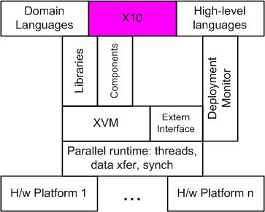
The X10 concept
Our Approach
  Design a clean, scalable, concurrent, imperative Java-based language.
  Reify distribution, emphasize asynchrony.
  Preserve determinacy, deadlock-freedom (where possible)
Focus on concurrency, synchronization, distribution, arrays.
<<Need something crisper about which specific problems app devel face that we solve. About focus on new problem domains. About exploiting new h/w trends>>
Few things, done well.

Slide 5
The X10 Programming Model
Place
Place
Partitioned Global heap
Outbound activities
Inbound activities
Partitioned Global heap
Place-local heap
Place-local heap
. . .
Activities
Activities
heap
stack
control
heap
stack
control
heap
stack
control
heap
stack
control
. . .
Inbound activity replies
Outbound activity
replies
. . .
Immutable Data
A program is a collection of places, each containing resident data and a dynamic collection of activities.
Program may distribute aggregate data (arrays) across places during allocation.
Program may directly operate only on local data, using atomic blocks.
Program may spawn multiple (local or remote) activities in parallel.
Program must use asynchronous operations to access/update remote data.
Program may repeatedly detect quiescence of a programmer-specified, data-dependent, distributed set of activities.
UPDATE. REMINDER OF MODEL.
Cluster Computing: P >= 1
Shared Memory (P=1)
MPI (P > 1)

Slide 6
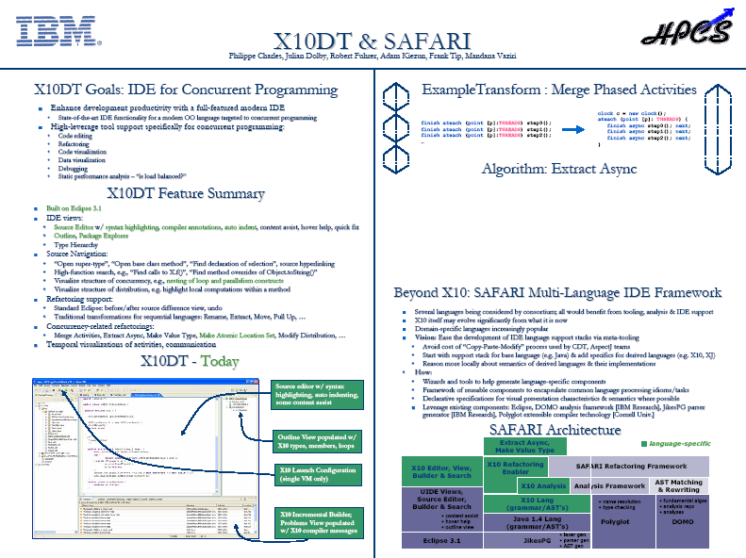
X10DT

Slide 7
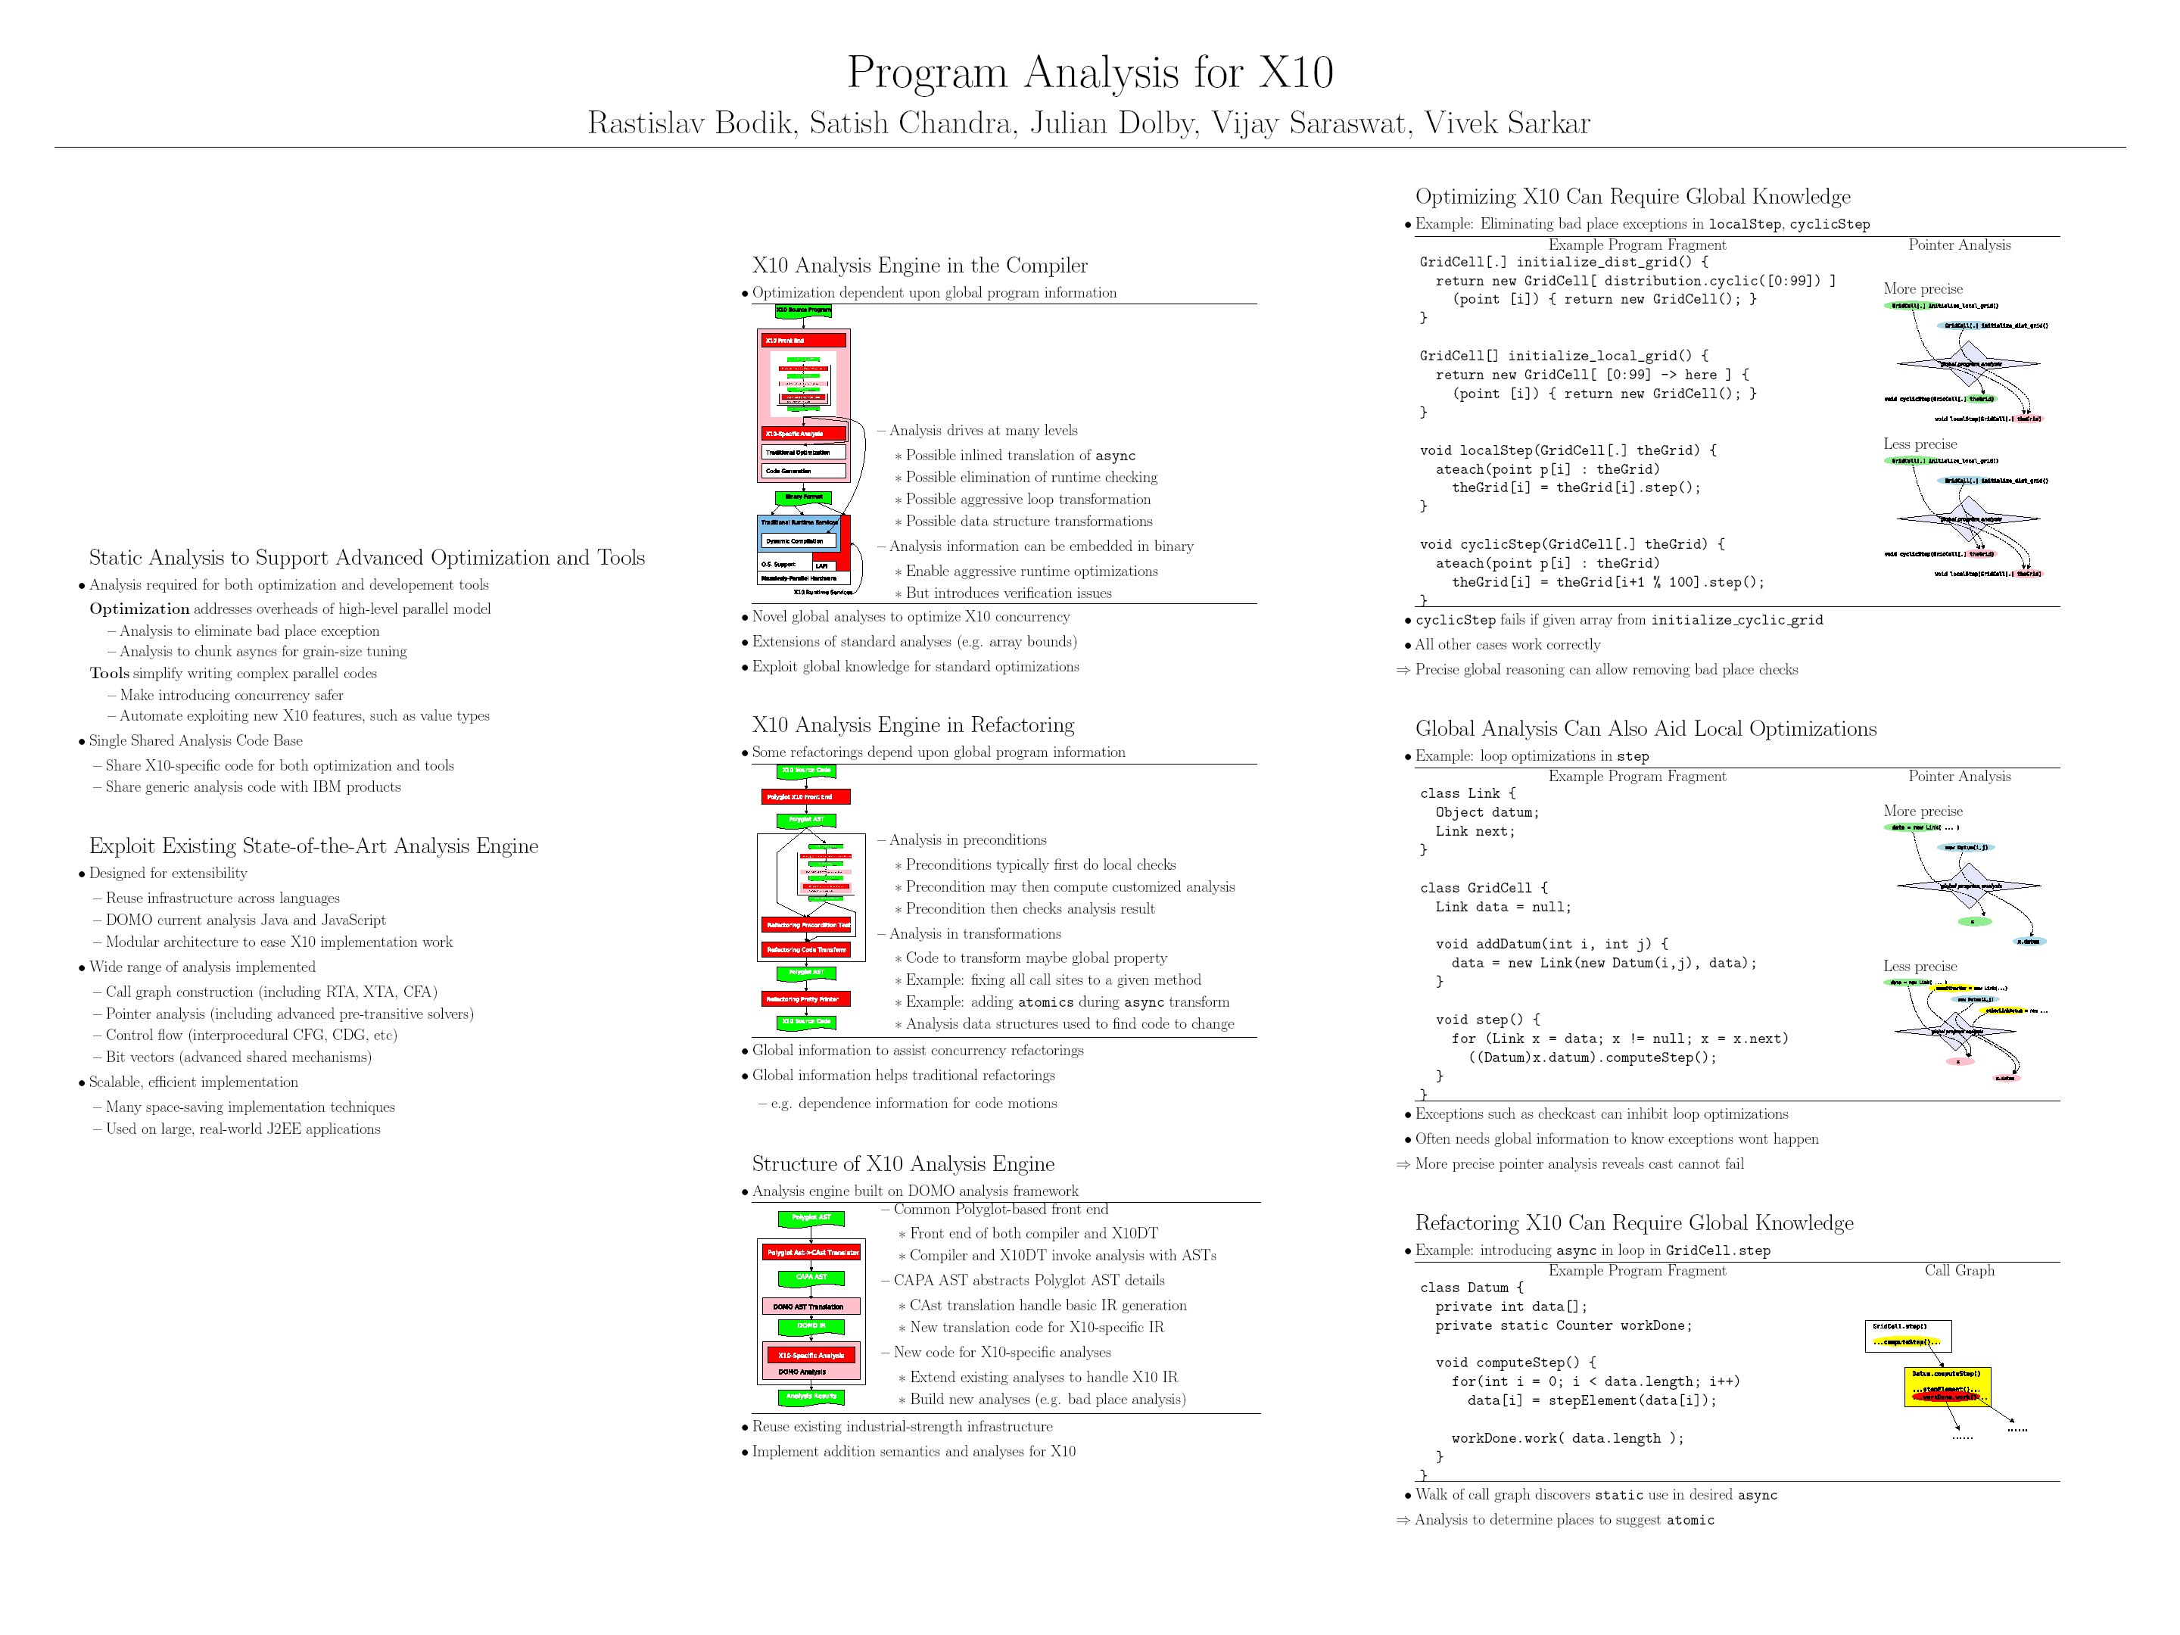
Static Analysis

Slide 8


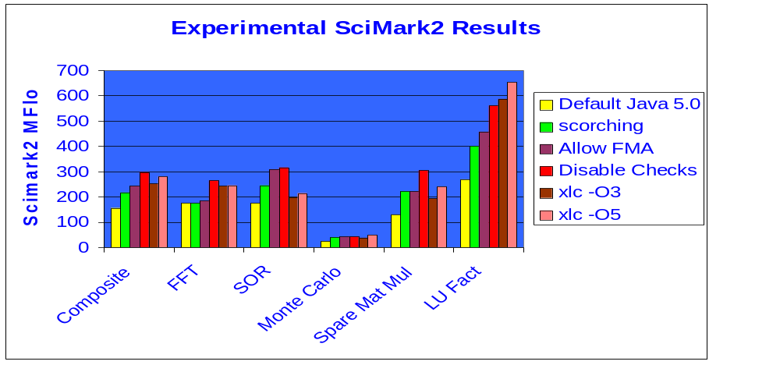
Single-thread JIT performance experiments
Issue | Java: | X10:
Fused multiply-add instruction | IEEE 754 correctness | More flexible FP rules
Null checks, bound checks | Extra code, inhibits optimizations | Static analysis to minimize
GC considerations | Extra code, register constraints | More GC awareness in executing code
Compilation Products – SWG Toronto Laboratory – IBM Confidential (Allan Kielstra, Christopher Donawa)

Slide 9
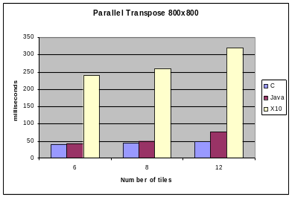
An X10 Multi-VM (Functional) Prototype
Based on IBM’s J9 VM
Single program across
many vms
Each VM knows about all other VMs and transfers data on demand
Asyncs (remote data manipulation) serialize needed data in runtime and send via LAPI
Low-level API (LAPI) communication library handles data transfers and synchronization issues
The X10 (Functional) Prototype Runtime
VM 1
X10
program
VM 1
X10
To run a program each VM:
loads the same program and configuration data.
Establishes LAPI connections
Place 0 runs main
Responsible for:
Coordinating communication with other places (and hence VMs). Maintains a map of places & their respective VMs.
Storage for places allocated to that VM.
Storage for any globally partitioned data (i.e. global arrays)
Mapping of global arrays to local storage
Serializing/deserializing objects copied between VMs
X10 runtime
X10 runtime
Array
map
Place
map
Place 0
Place 1
LAPI
VM0
VM2
VM3
LAPI
…
VM 0
x10
VM 2
x10
VM 3
x10
Globally partitioned array
X10 runtime
X10 runtime
X10 runtime
Vm 0
LAPI
LAPI
LAPI
LAPI
Transpose Example
VM 0
VM 1
Results
Three versions of a parallel transpose used: C, Java and X10 style, all based on the LAPI library
Tile size: 800x800 (640000) 4-byte longs
System Model: IBM,7040-671: PowerPC_POWER4
Number Of Processors: 16: Clock Speed: 1100 MHz
Memory Size: 131072 MB
X10 allocates one VM per tile.
Src array
Source
Array tile
Dest array
Partitioned
T
Temp
buffer
Result
Array tile
Source and destination arrays distributed in equal sized tiles among VMs
VMs copy source tile into temporary buffer at destination
Transpose from temp buffer to result tile
X10 Issues
Functional prototype is not at all optimized
When sending data, X10 runtime performs extra copies that C & Java versions do not. These can be optimized away
C and Java required sophisticated LAPI coding
X10 very simple to program
Future Plans
Improve serial performance
Improve serialization e.g. implement ‘zero-copy’ transfers
  Make X10 performance close to Java
Tune X10 runtime
VM 2
VM 3
Compilation Products – SWG Toronto Laboratory – IBM Confidential (Allan Kielstra, Christopher Donawa)

Slide 10
Applications: SSCA
SSCA2
  Code developed by Fatih, Madduri (Bader).
  (Bar graph showing SLOC)
SSCA3
  Translated to StreamIT + X10
  Compiler translates StreamIt to X10.
  (Details awaited from Rodric.)
X10 | 690
MATLAB | 1123
OpenMP | 670
C-pthreads | 1323
Feo MTA-2 | 1039
SSCA#1 basis for PSC study 05/12.

Slide 11
Other programs
NAS PB: MG
  SLOC count (favorable)
  Representation of multi-grid view arrays of regions. (Code snippet)
Also
  Sweep3d (Jim Brown)
  HTA integration (David Padua)

Slide 12
Applications: AMR (IN PROGRESS)
Problem statement
Code size
Concurrency representation in X10.

Slide 13
Current Status
Reuse structure, revamp content.
09/03
PERCS Kickoff
02/04
We have an operational X10 0.41 implementation
X10 Kickoff
07/04
X10 0.32 Spec Draft
Code Templates
X10 Multithreaded RTS
X10 Grammar
Annotated AST
Target Java
Native code
AST
02/05
Parser
Analysis passes
Code emitter
JVM
X10 Prototype #1
X10 source
PEM Events
Structure
  Translator based on Polyglot (Java compiler framework)
  X10 extensions are modular.
  Uses Jikes parser generator.
Code metrics
  Parser: ~45/14K*
  Translator: ~112/9K
  RTS: ~190/10K
  Polyglot base: ~517/80K
  Approx 180 test cases.
  (* classes+interfaces/LOC)
Program output
07/05
Limitations
  Clocked final not yet implemented.
  Type-checking incomplete.
  No type inference.
  Implicit syntax not supported.
X10 ProductivityStudy
12/05
X10 Prototype #2
06/06
Open Source Release?

Slide 14
Future Work
Open source release
  Runtime enhancements
  Compiler enhancements
Phase III work
  Scalable implementation
  Static analysis
  X10DT
  Applications
  Language evolution

Slide 15
Backup

Slide 16
Motivation
Common requirements for UPC and X10 runtime platform:
  partitioned global address space
  collective communication and synchronization
Differences:
 |  | UPC | X10
threading
global |  | SPMD | activities
local |  | n/a | activities
memory |  | pointers | object references
local / remote access |  | implicit | explicit
consistency |  | strict / relaxed | strict
synchronization
local |  | n/a | transactions
point-point |  | locks | transactions
global |  | split-phase barriers | clocks
arrays distribution |  | one-dim. block cyclic | multi-dim. various distributions

Slide 17
UPC / X10 Synergies
X10 restricts UPC
(storage, memory access)
  → UPC provides implementation of X10 features
X10 generalizes and extends UPC
(dynamic threading, synchronization, multi-dimensional arrays)
  UPC implements subset of X10 features
Strategy
UPC runtime system as a foundation.
Extend it to lightweight runtime system for a subset of X10.
Focus on scalability issues, not on completeness of language implementation.
First step toward “distributed VM”.
Target architecture: BlueGene/L.

Slide 18
Lightweight Runtime System
Features:
System partitioning (X10: places)
Partitioned global address space (PGAS), object model with remote references
Distributed multi-dimensional arrays with hierarchical tiling (HTAs)
Intra-partition: fine grain parallelism and local transactions
Inter-partition: collective communication, higher-level synchronization primitives (clocks)
Performance and resource monitoring
Not supported:
Dynamic compilation and optimization
Dynamic class management, loading and linking
Fully automated memory management
Full implementation of distributions and regions

Slide 19
Example Use in Synchronous Models
MAYBE WORKED OUT EXAMPLE OF FLEXIBILITY OF CLOCKED ASYNCS FOR RDMA.
Send each column as computed
Computer first and send along dimension that is contiguous
Use RDMA pipelining as applicable
Use striping if same data needs to be sent to multiple destinations
Achieves:
  More effective pipelining
  Effective overlap
  Improved sustained performance
Iteration -- j
Iteration -- i
References: - Hunting the overlap, Costin Iancu
- Kathy Yelick’s work on bulk synchronous models and UPC

